Slide 1
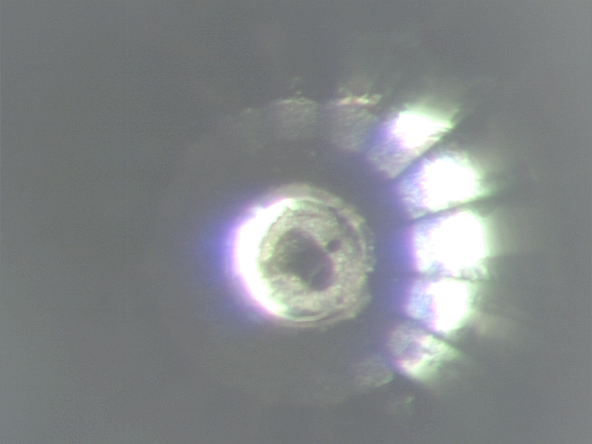
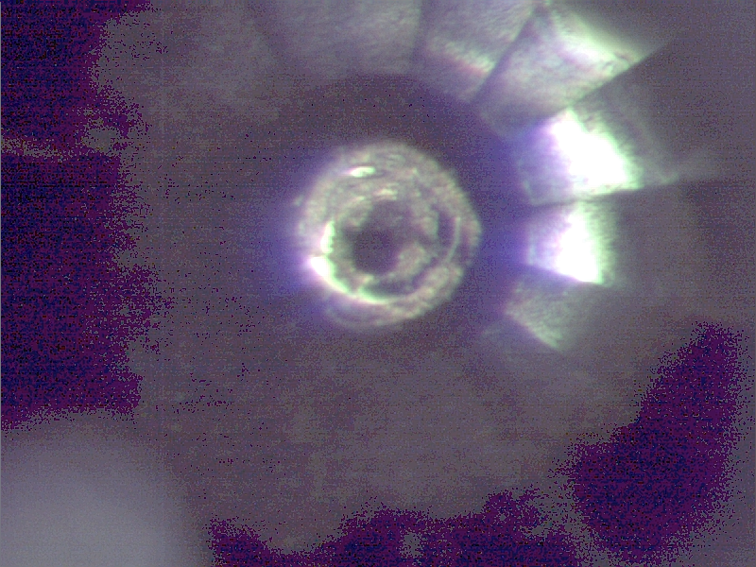
FO73a after heating A
2 April 2010
Note laser melted spot on
Boundary of Fe ring and FeO
Center plug
Upstream
Downstream

